Slide 1
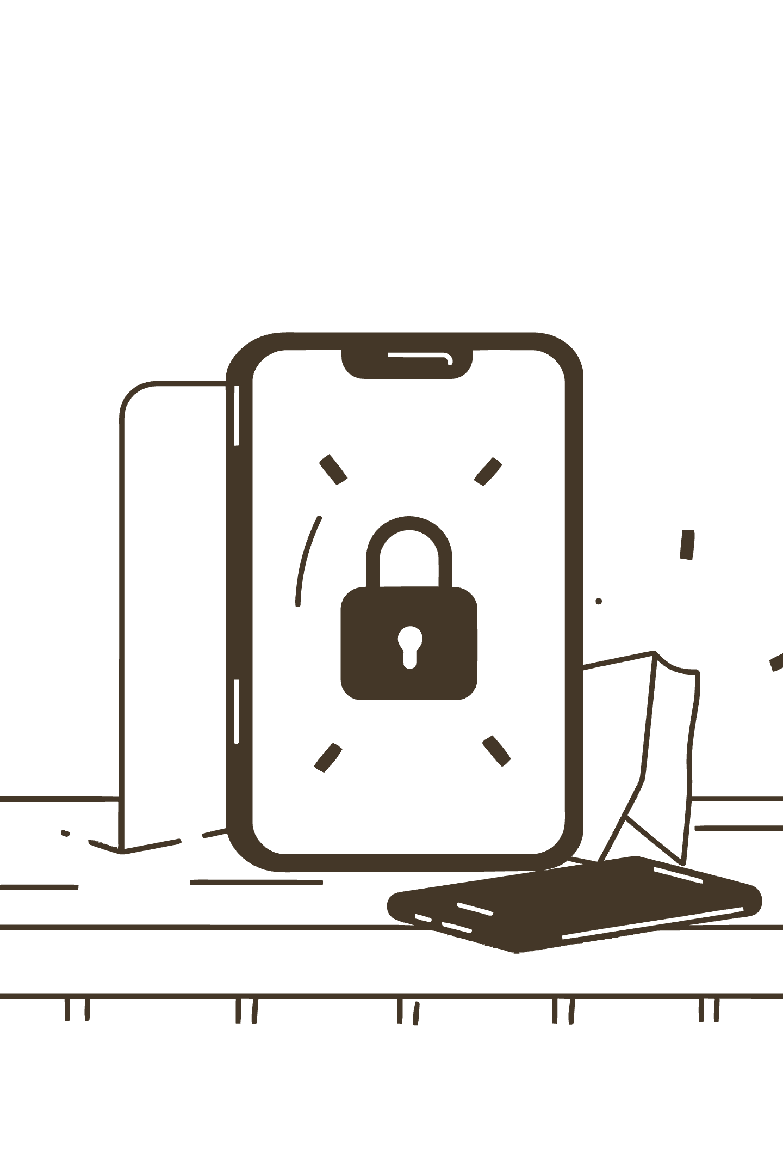

AgentTesla Malspam Campaign
SOC INCIDENT REPORT
04 DECEMBER 2024
TLP:RED
Globex Manufacturing Ltd. | Analyst: Ukah Paul | Classification: HIGH
AgentTesla infostealer successfully delivered, executed, and exfiltrated ~38 KB of browser credentials and keylog data via cleartext FTP to an attacker-controlled server.

Slide 2
Incident Overview
38KB
~20min
Data Exfiltrated
Keylog Duration
Browser credentials and keylog data stolen across 4 files
Active keystroke capture before second FTP session
2
HIGH
FTP Sessions
Risk Rating
Automated exfiltration sessions to attacker-controlled server
Phishing-based malware infection with confirmed credential theft
Incident Details
Analysis Scope
Organisation: Globex Manufacturing Ltd.
Incident Date: 04 December 2024
Classification: Phishing-based Malware Infection
Phase 1: Email and Attachment Forensics
Phase 2: Network PCAP Investigation
Malware Family: AgentTesla — keylogger, browser credential stealer, FTP exfiltrator
Victim Host: DESKTOP-VJCRXEB — user gary.strickman

Slide 3

Threat Identified
What Was Delivered and What It Did
Attack Type
Targeted spear-phishing (malspam) via malicious attachment — email impersonating Turkish supplier Acron Su ve Çevre Teknolojileri A.Ş.
Payload
TECHNICAL SPECIFICATIONS.exe — PE32 .NET assembly, 1.05 MB, compiled same day as delivery (2024-12-04 00:02). Delivered inside a RAR archive disguised with a .TAR extension.
Evasion Technique
File masquerading chain — .TAR extension conceals a RAR archive hiding a Windows executable. MITRE T1036.008 (Masquerading: Wrong Extension) + T1027 (Obfuscated Files).
Confirmed Impact
Browser credentials from Chrome and Edge stolen; 20 minutes of keystrokes captured; all data exfiltrated via cleartext FTP to attacker-controlled server at ftp.ercolina-usa.com.

Slide 4

Attack Timeline
From Email Delivery to Active Exfiltration
12:51 UTC
1
Phishing email received. Subject: PURCHASE QUOTATION. Sender: sertan@acronas.com.tr (IP: 94.141.120.32). SPF softfail, DKIM none, DMARC none.
2
~21:20 UTC
Victim opens TECHNICAL SPECIFICATIONS.TAR and executes TECHNICAL SPECIFICATIONS.exe — approximately 8.5 hours after email receipt.
T+0s (21:20:50)
3
AgentTesla executes. First action: DNS query to api.ipify.org — public IP discovery. T+6s: DNS resolution of ftp.ercolina-usa.com → 192.254.225.136. FTP Session 1 initiated.
4
T+7–9s
Three files exfiltrated in rapid succession: browser password dump (392 B), Chrome credentials (~23 KB), Edge credentials (~11 KB). Keylogger silently activates.
T+1211s (21:41:02)
5
FTP Session 2. Keylog data uploaded (~1.4 KB). Total stolen: ~38 KB across 4 files. C2 beacon interval confirmed at ~20 minutes (1,211 seconds).
Total time from execution to complete exfiltration: approximately 20 minutes and 12 seconds. All activity was automated — no further user interaction required after initial execution.

Slide 5
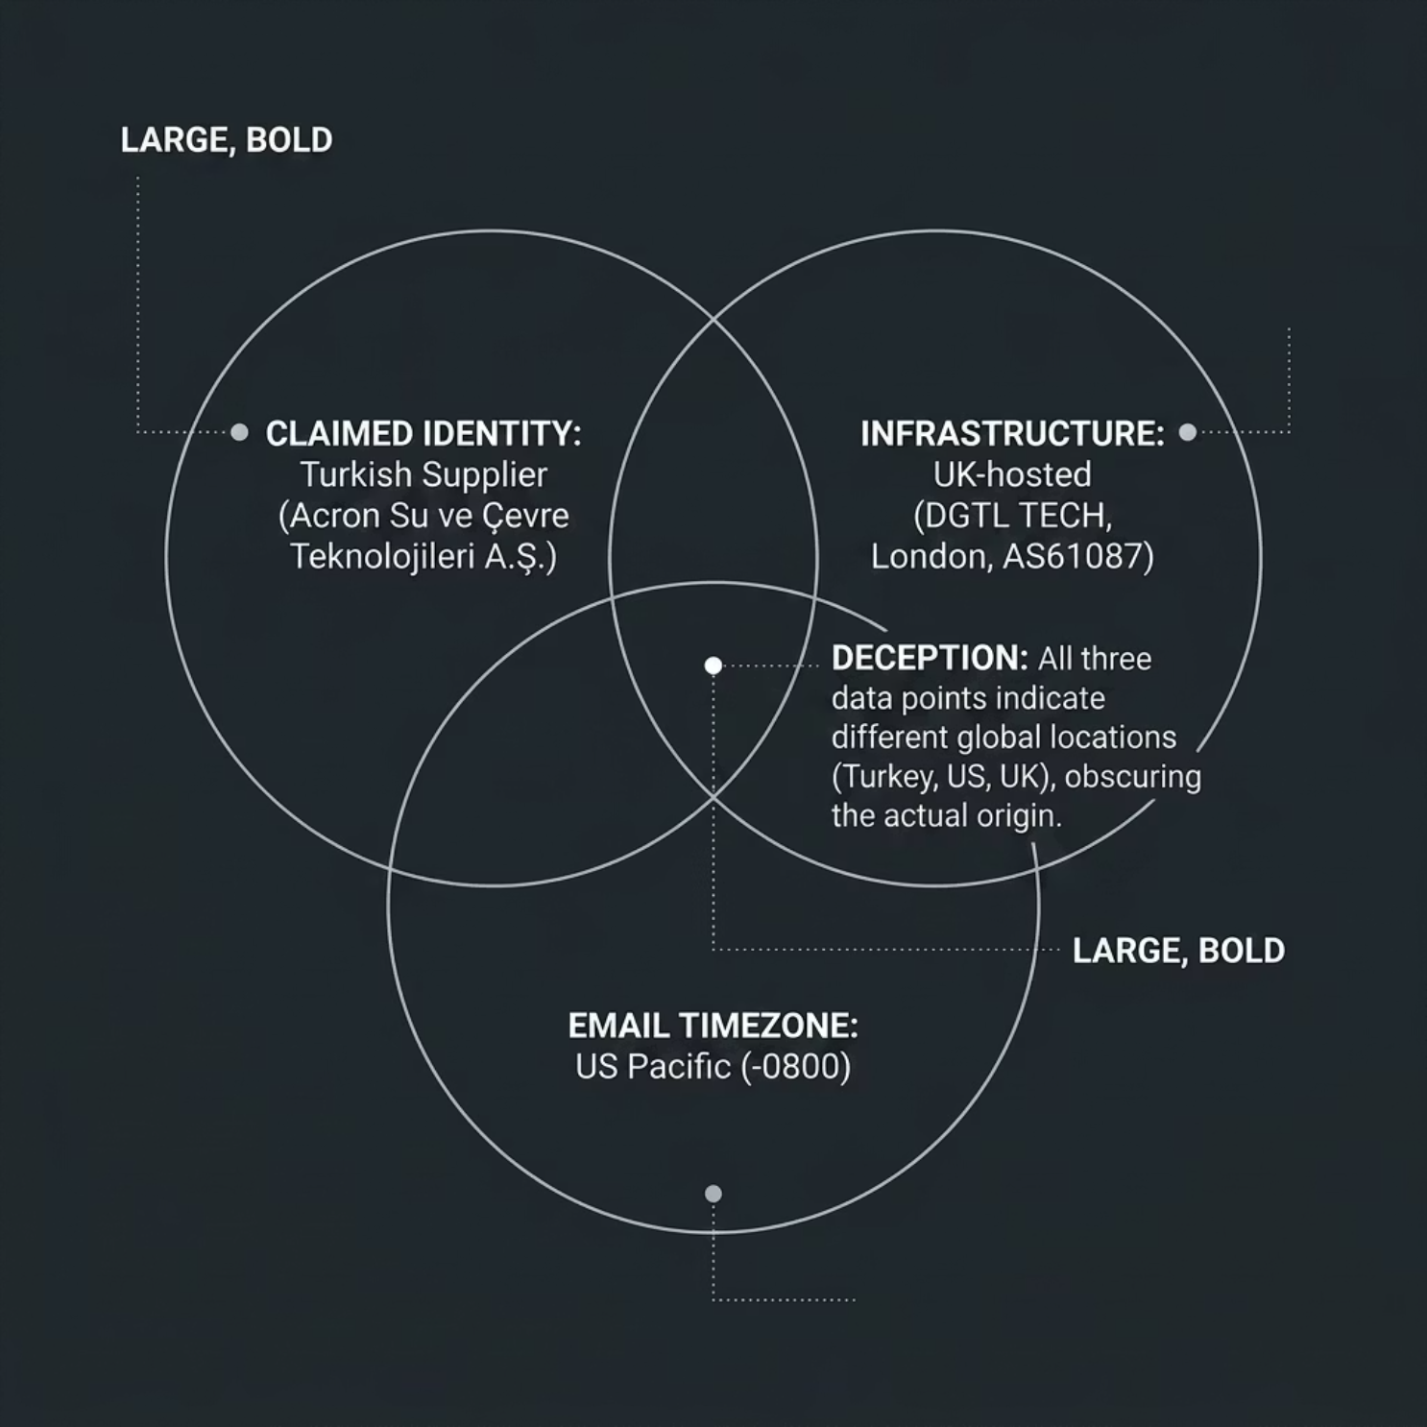

Email & Sender Analysis
Phase 1 — Phishing Email Forensics
Authentication Failures — All Three Controls Failed
SPF: Softfail
Sending IP 94.141.120.32 not explicitly authorised by the domain's SPF record.
DKIM: None
No cryptographic signature present — message authenticity cannot be verified.
DMARC: None
No enforcement policy — email gateway had no automated rejection mechanism.
IP subnet 94.141.120.0/24 was registered in RIPE 7 days AFTER the attack — a classic throwaway/bulletproof hosting pattern via AS61087 (DGTL TECH UK LLP, virtual office address).

Slide 6





Attachment & Payload Analysis
Phase 1 — Malicious Attachment Forensics
Layer 1: .TAR Extension
Declared as TAR archive (application/x-tar) — designed to appear as a harmless technical document archive.
Layer 2: RAR Archive
Magic bytes confirm actual format is RAR v4, os: Win32 — MITRE T1036.008 (Masquerading: Wrong Extension).
Layer 3: PE32 .NET EXE
TECHNICAL SPECIFICATIONS.exe — 1,096,704 bytes (1.05 MB), compiled 2024-12-04 00:02, same day as delivery. MITRE T1027.
Static String Indicators (No Execution Required)
File Hashes (SHA256)
pbHidePassword, txtPassword, pbShowPassword_Click, set_PasswordChar — credential harvesting UI components embedded in binary strings
RAR: 5c98308c69c84a57214442e2cadc9f8f0fcdbab8e6050f9915ac336b6f1d59f0
VirusTotal Detections
EXE: d1b068b826e3a9527cddd09866886caba895f390af930a9b35c027eb1c2db34c
RAR Container: MALICIOUS — Trojan/AgentTesla (Antiy-AVL: Trojan/Win32.AgentTesla Keylogger)
EXE Payload: MALICIOUS — Trojan.msil/Strictor (multiple vendor detections)

Slide 7

Network Investigation Findings
Phase 2 — PCAP Forensic Analysis
Infected Host
PCAP Summary
Internal IP
10.12.4.101
182 Total Frames
42 FTP Control Frames
Hostname
DESKTOP-VJCRXEB
Complete capture of malware network activity
Command channel — credentials transmitted in cleartext on the wire
User
gary.strickman
OS
Microsoft Windows 11 Pro
Public IP
173.66.46.97
27 FTP Data Frames
3 DNS Queries Only
C2 / Exfiltration Server
Active exfiltration confirmed — 4 files transferred across 2 sessions
Zero background noise — every query deliberate and malware-driven. C2 re-resolved before each beacon session.
Domain
ftp.ercolina-usa.com
IP
192.254.225.136
Protocol
FTP Port 21 — cleartext
FTP credentials for account ben@ercolina-usa.com were transmitted in cleartext and are fully recoverable from the PCAP capture.
Server
Pure-FTPd [privsep]

Slide 8
Data Exfiltrated
What the Attacker Stole — Four Files Recovered Directly from PCAP
Module
Filename
Size
Content
PW_
PW_gary.strickman-DESKTOP-VJCRXEB_2024_12_04_21_20_57.html
392 B
Saved browser password vault (Edge)
CO_
CO_Chrome_Default.txt_...2024_12_04_21_21_03.txt
~23 KB
Chrome saved credentials & session cookies
CO_
CO_Edge Chromium_Default.txt_...2024_12_04_21_21_04.txt
~11 KB
Edge credentials & cookie store
KL_
KL_gary.strickman-DESKTOP-VJCRXEB_2024_12_04_21_41_04.html
~1.4 KB
20 minutes of captured keystrokes
~38KB
4
Total Stolen
Files Exfiltrated
Across 2 automated FTP sessions
All recovered from PCAP in cleartext
~23KB
20min
Chrome Credentials
Keystrokes Captured
Largest single file — saved passwords and session cookies
Silent keylogger active between FTP Session 1 and Session 2
All credentials for user gary.strickman must be treated as fully compromised. This includes browser-stored passwords, corporate accounts, and all SSO identities accessible from the affected workstation.

Slide 9
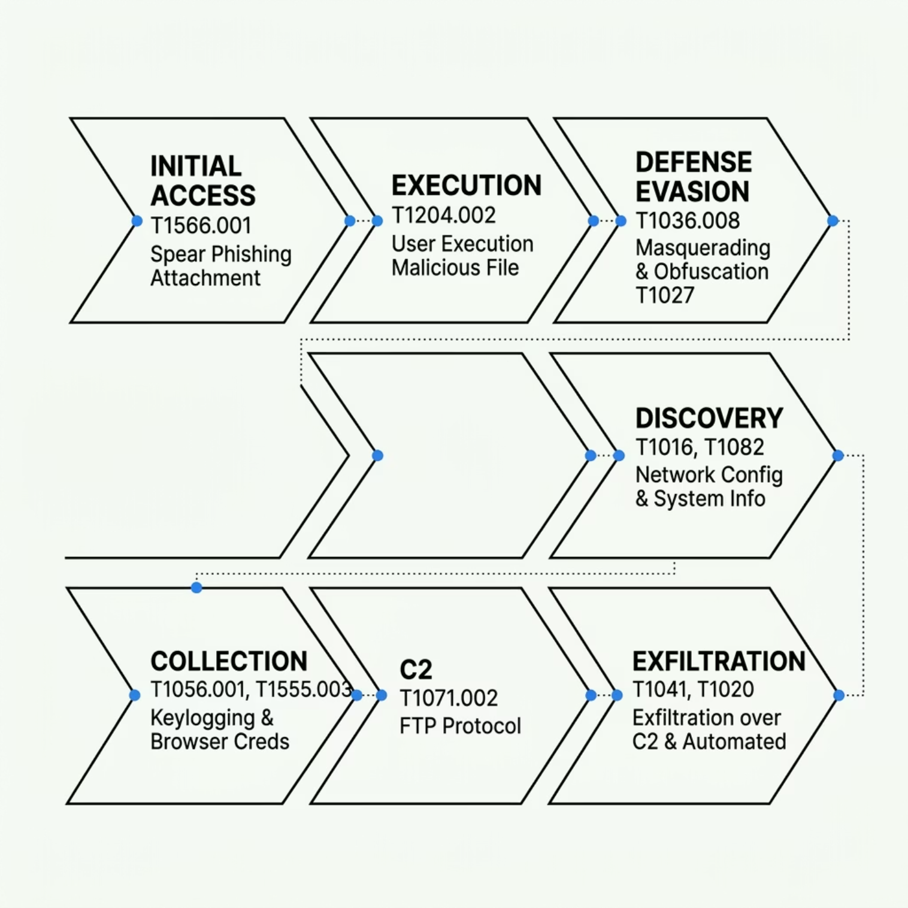
MITRE ATT&CK Mapping
Adversary Techniques Identified Across Both Phases
Initial Access & Execution
Defense Evasion
T1566.001 Spear Phishing Attachment
T1204.002 User Execution: Malicious File
T1036.008 Masquerading: Wrong Extension
T1027 Obfuscated Files or Information
Collection & Discovery
C2 & Exfiltration
T1056.001 Input Capture: Keylogging
T1555.003 Credentials from Web Browsers
T1016 System Network Configuration Discovery
T1071.002 Application Layer Protocol: FTP
T1041 Exfiltration Over C2 Channel
T1020 Automated Exfiltration

Slide 10

Recommended Actions
Immediate Response Priorities
Contain — Now
Credential Reset — Urgent
Isolate DESKTOP-VJCRXEB (10.12.4.101) from network — pending full forensic imaging
Block IPs 94.141.120.32, 94.141.120.0/24, 192.254.225.136 at perimeter firewall
Block domain ftp.ercolina-usa.com at DNS and proxy
Mandatory reset of all credentials for user gary.strickman
Browser-stored passwords, corporate accounts, and SSO identities all confirmed compromised
Email Gateway Hardening
SIEM / Threat Hunting
Block compressed archives containing executables at email gateway
Quarantine SPF softfail messages; enforce DMARC p=reject
Flag .TAR/.RAR attachments containing .exe for analyst review
Deploy all SHA256 hashes to EDR and SIEM detection rules
Hunt for DNS queries to api.ipify.org followed by outbound FTP
Search for PW_/CO_/KL_ file naming patterns in endpoint logs
Block outbound FTP (port 21) from all workstations — not a business-required protocol
Key IOCs for Immediate Deployment: Network: 94.141.120.32 / 94.141.120.0/24 / 192.254.225.136 / ftp.ercolina-usa.com | Email: sertan@acronas.com.tr / acronas.com.tr | Hashes: RAR 5c98308c… / EXE d1b068b8… | Behavioural: Outbound FTP port 21 from workstations + api.ipify.org DNS queries

